Slide 1
Electric Vehicle Charging Demand Forecasting
- Sanskriti Rai

Slide 2
Project Scope and Data Sources
EV adoption → Rising need for optimized charging infrastructure.
Objective → Forecast demand, optimize placement, capacity & operations.
Dataset: 3 years (2018-2020) from Palo Alto stations (~100k sessions); Timestamp, duration, energy.
Integrated with weather (Meteostat) and traffic data (116k events); Temp, humidity, rain, wind.
Focus: Predict daily and weekly charging demand; Congestion, accidents, closures.

Slide 3
Methodology
Data cleaning, feature engineering.
Model: Prophet (handles seasonality, holidays, outliers).
External Regressors: Weather, Traffic.
Cross-validation: Expanding window.

Slide 4
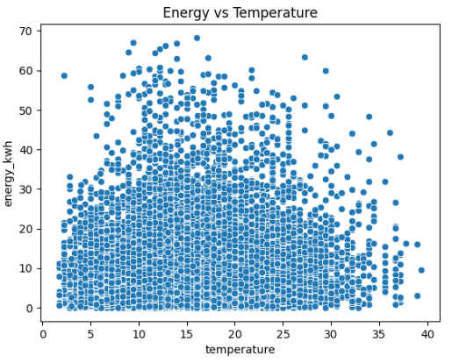
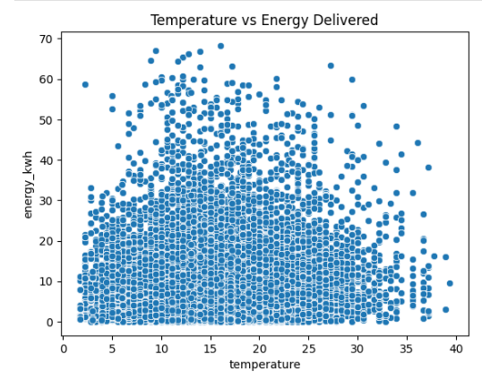
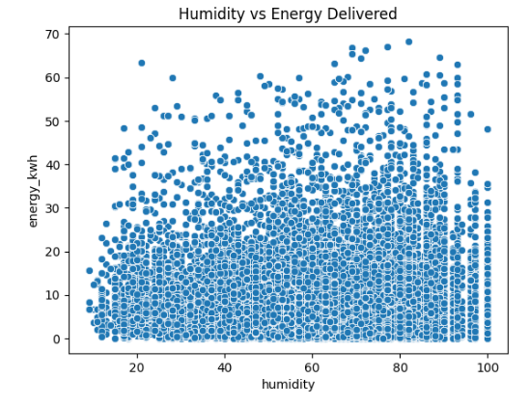
Key Findings - Temporal Patterns
Weekdays → Morning & evening peaks.
Weekends → Midday peaks.
Seasonality → Summer > Winter usage.
High demand: Tuesday-Thursday.

Slide 5
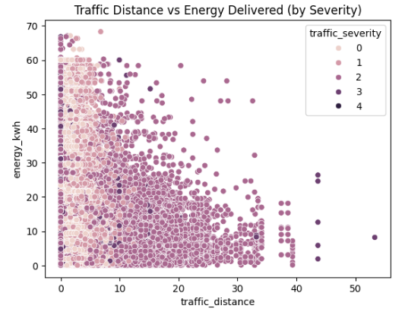
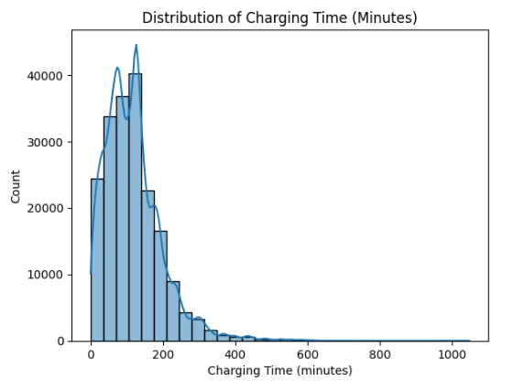
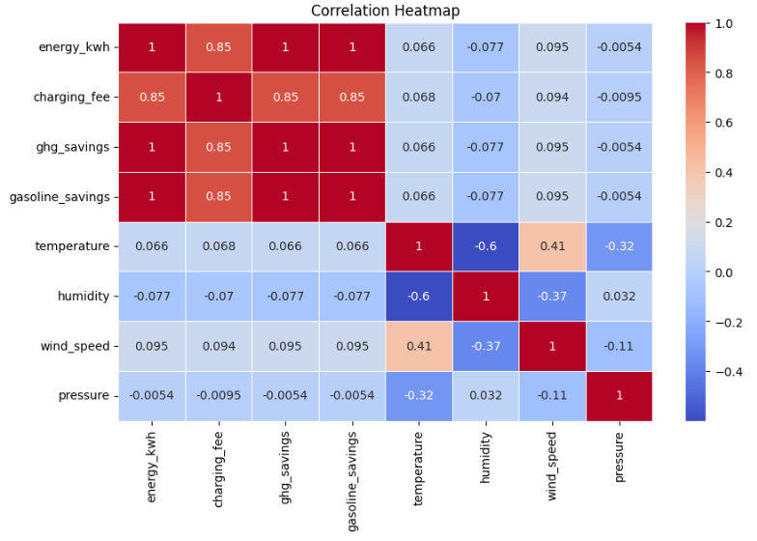
Key Findings - Weather and Traffic Impact
Temperature: +0.43 correlation with longer sessions (15-25°C ideal).
Rain: -0.38 correlation → less charging.
Traffic Congestion: -0.35 correlation with station availability.

Slide 6
Forecast Summary
Horizon | Avg Prediction (kWh) | Avg CI Width (kWh)
Next Day | 9.72 | 11.32
Next Week | 9.77 | 11.44
Next Month | 10.13 | 12.38
3 Months | 10.69 | 13.28
6 Months | 11.16 | 14.12
1 Year | 11.65 | 15.00

Slide 7
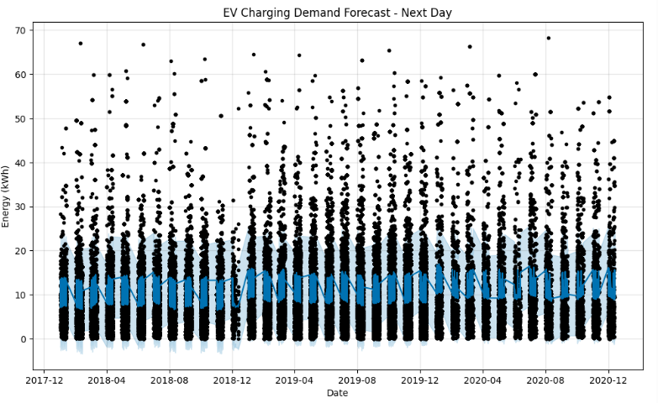
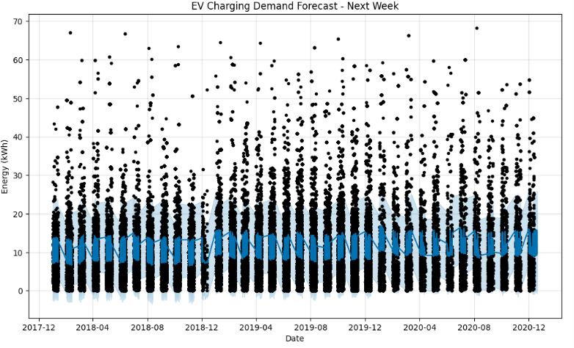
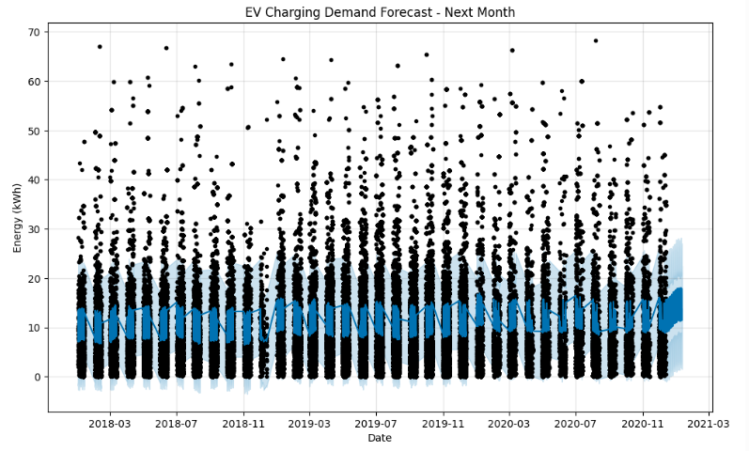
Forecast: 1-Day, 1-Week & 1-Month

Slide 8
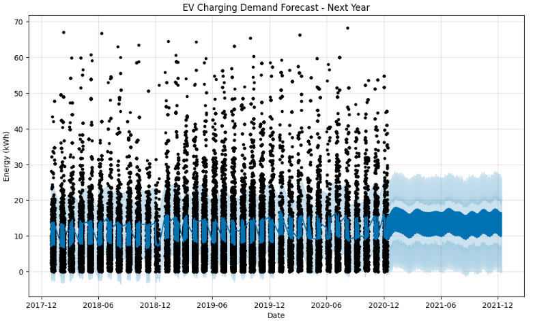
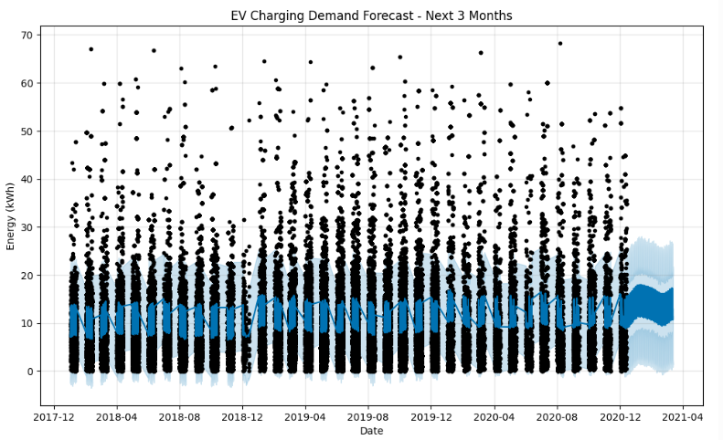
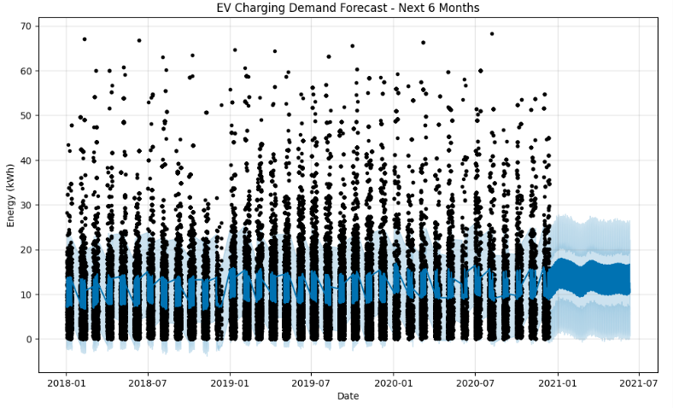
Forecast: 3-Months, 6-Months & 1-Year

Slide 9
Charging Optimization Strategy
Capacity Optimization: Expand ports where >80% occupancy during peaks.
Smart Location Planning: Target high-traffic, low-availability zones.
Charger Type Mix: Fast chargers (DC) for short stops; Level 2 for longer stays.
Dynamic Pricing: Shift demand to off-peak periods.
Predictive Maintenance: Schedule based on low-usage forecasts.
User Communication: Share forecasted availability in apps.
Grid Coordination: Manage load with utilities during high-demand.

